Slide 1



Saga Design Pattern: Choreography in Event-Driven Microservices
VB
by Visal Krishnan B

Slide 2
Monolithic vs Microservices
Monolithic
Microservices
Traditional approach with a single, large application.
Decentralized architecture with smaller, independent services.
Difficult to scale and maintain.
Enhanced scalability, flexibility, and resilience.

Slide 3

Introduction to Saga Design Pattern
Distributed Transactions
Saga Pattern
Ensuring consistency across multiple services.
Sequence of local transactions to achieve global consistency.
Choreography Method
Services communicate via events, without a central orchestrator.
Orchestration Method
A central coordinator (orchestrator) to help preserve data integrity in distributed transactions that span multiple services

Slide 4




Event-Driven Microservices Architecture
Event Production
Services publish events to a message bus.
Event Consumption
Other services subscribe to relevant events.
Asynchronous Communication
Loose coupling between services, enhancing scalability.

Slide 5

Choreography Method in Saga Pattern
1
Decentralized Control
2
Event-Driven Communication
No central orchestrator, services communicate directly.
Services react to events, ensuring asynchronous flow.
3
Loose Coupling
Services are independent, allowing for flexible scaling.

Slide 6
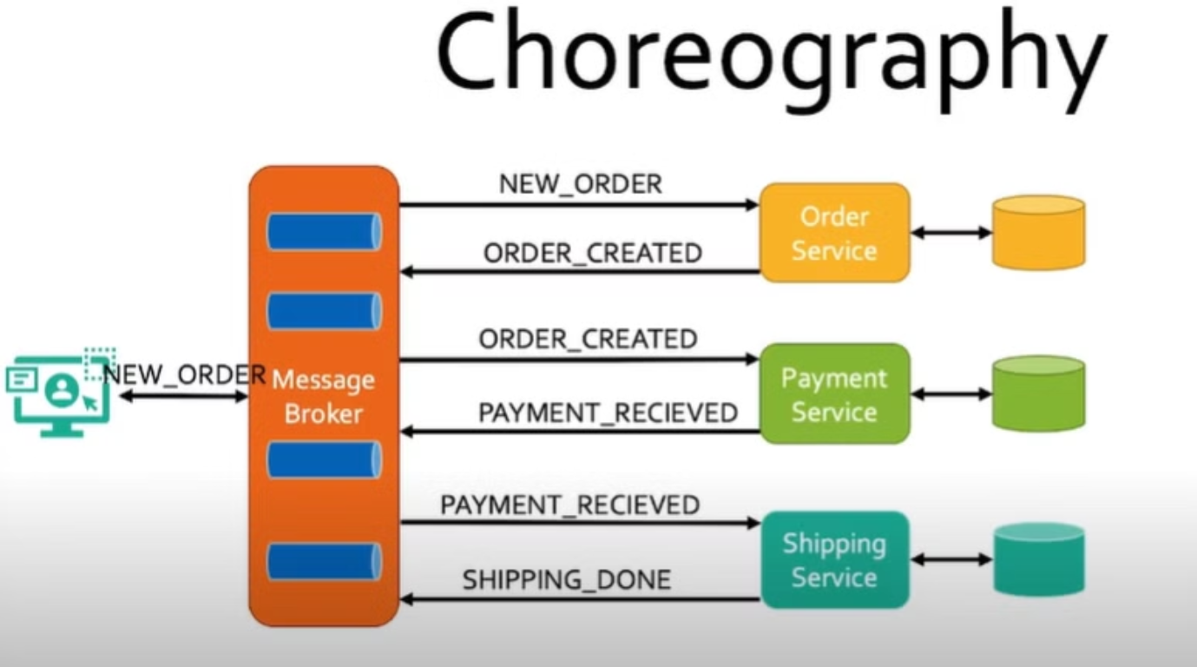

Slide 7
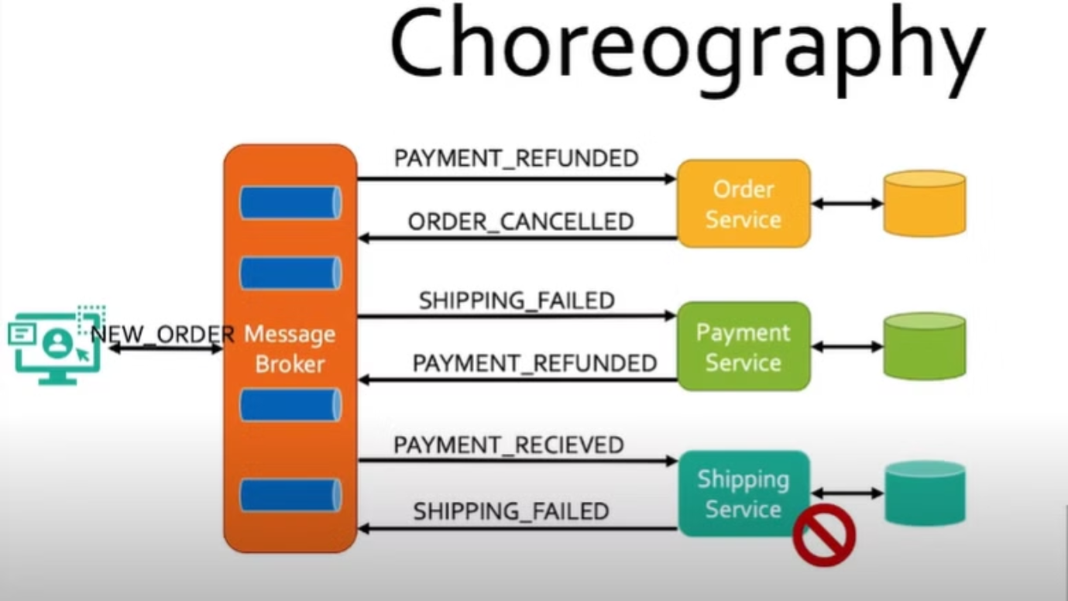

Slide 8

Advantages of Choreography-based Saga
Flexibility
Easy to add new services or modify existing ones.
Scalability
Each service can be scaled independently.
Resilience
Failure of one service does not necessarily affect others.
Disadvantages :
Implement complex observability and track what's happening

Slide 9

Implementing Choreography-based Saga
1
Event Handling
Services listen for and handle relevant events.
2
Transaction Management
Each service manages its own local transactions.
3
Compensating Transactions
Rollback mechanism to ensure consistency in case of failures.

Slide 10




Handling Compensating Transactions
Rollback Actions
Failure Detection
Consistency Restoration
Each service implements compensating actions.
Mechanism to detect failures and trigger rollback.
Ensuring data consistency after a failure.

Slide 11
